Slide 1

Identifying Fraud Job Postings Using Machine Learning Classification Methods
By:- Paresh Patil

Slide 2
What is Machine Learning?
Machine learning is a subfield/subset of Artificial Intelligence (AI) that focuses on the development of algorithms and execute models that enables system to learn automatically and make predictions or decisions based on data.
The main goal of machine learning is to develop algorithms that can improve their performance over time through experience. This is often achieved by training a model on a large dataset, allowing it to identify underlying patterns, trends, and correlations in the data. Once the model has been trained, it can then make predictions or decisions on new, unseen data.
There are several key components and concepts within machine learning: Data/Data Quality, Features, EDA, Visualizing, training-testing, Models,etc.
Machine learning has a wide range of applications, including image recognition, Natural language processing, Recommendation systems, Various price predictions, medical diagnosis, financial modeling, identifying fraudulent problems in different sectors, etc.

Slide 3

Problem Statement
Machine learning’s one of the use is to save time and efficiency and help to reduce fraud. Today’s job search candidates utilize many online job boards to search and apply for jobs and it is both wasteful of time and potentially dangerous if they apply for a job posting that is fake. Worse yet, they can unknowingly give up personal information or other potential security concerns by responding to fake job postings.
Objective:- To identify whether the posted job is fraud or real.
It would be highly beneficial if we can save the time for these candidates by identifying and labeling those postings which are suspected to be fake. In this project I have tried to tackle this problem by training and evaluating the performance of several machine learning models to identify these fake job postings

Slide 4

Data Set
For this project, I used a Kaggle Dataset of Job Postings: https://www.kaggle.com/shivamb/real-or-fake-fake-jobposting-prediction/data#
This is a supervised learning task so the data contains the binary target class labels.
Data contains 18k job postings, of which few are labeled as fake.
This dataset contains 18 features (columns) including the target class label.

Slide 5

About the data set
Data Features
job_id- Identification number given to each job posting.
title- A name that describes the position or job
location- Information about where the job is located
department- Information about the department this job is offered by
salary_range- Expected salary range
company_profile- Information about the company
description- A brief description about the position offered
requirements- Pre-requisites to qualify for the job
benefits- Benefits provided by the job

Slide 6
About the data set
telecommuting- Is work from home or remote work allowed
has_company_logo- Does the job posting have a company logo
has_questions- Does the job posting have any questions
employment_type- 5 categories – Full-time, part-time, contract, temporary and other.
required_experience- Internship, Entry Level, Associate, Mid-senior level, Director or Executive
required_education- Can be – Bachelor’s degree, high school degree, unspecified, associate degree, master’s degree, certification, some college coursework, professional, some high school coursework, vocational
Industry-The industry the job posting is relevant to
Function-The umbrella term to determining a job’s functionality
Fraudulent-Target variable → 0: Real, 1: Fake

Slide 7
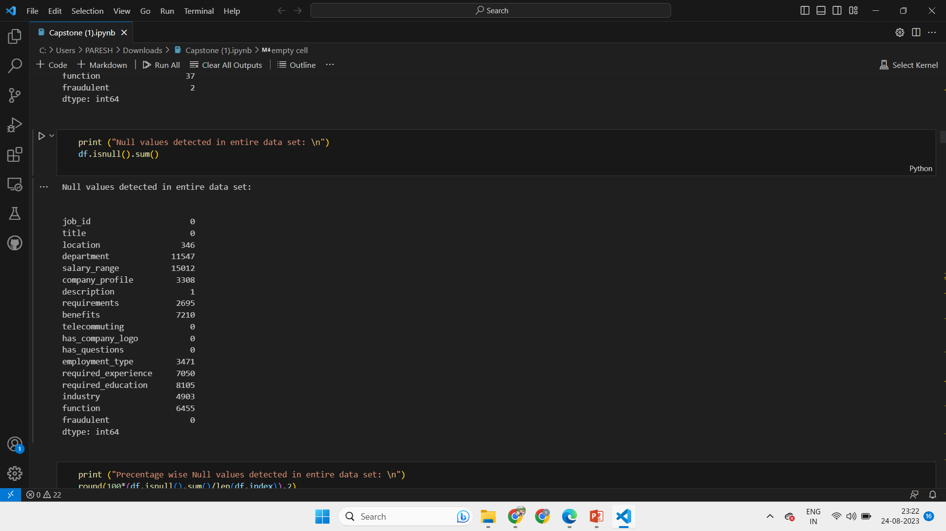
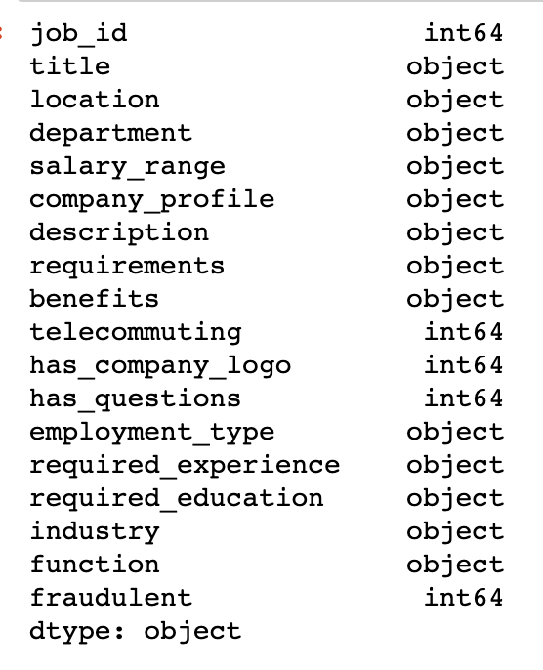
EDA/Data Preparation
This dataset is is almost entirely consisting of categorical features of object type. The few numeric features are Boolean representations of the data.
There were very few duplicate values in the dataset, so we dropped the duplicate records as it wouldn’t affect our model more.
However, there were a number of missing values identified in some of the columns which I handled.

Slide 8
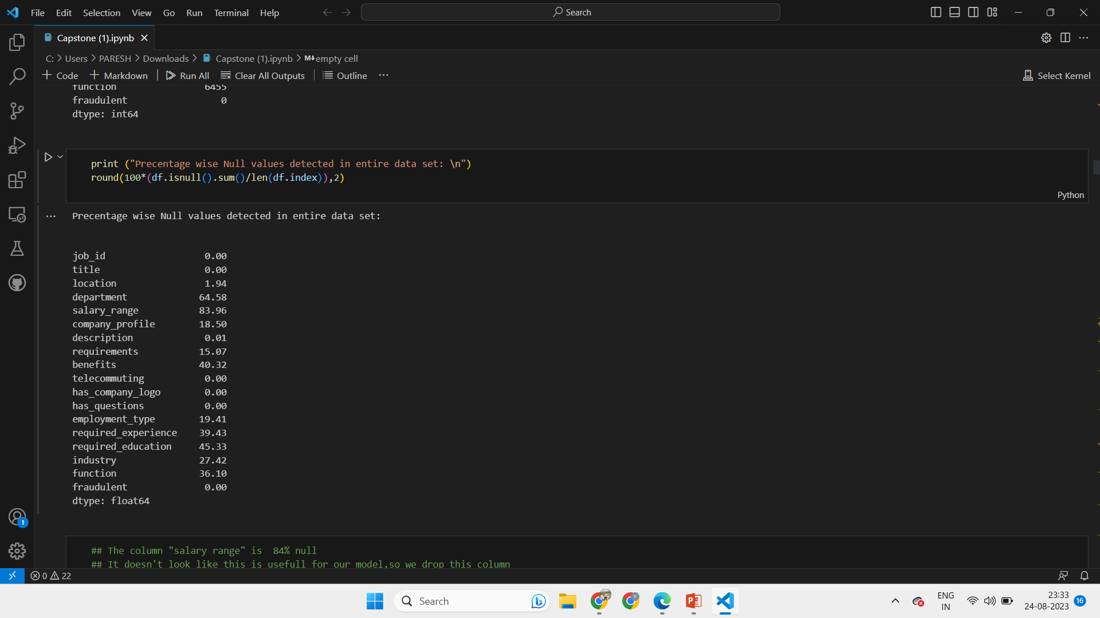
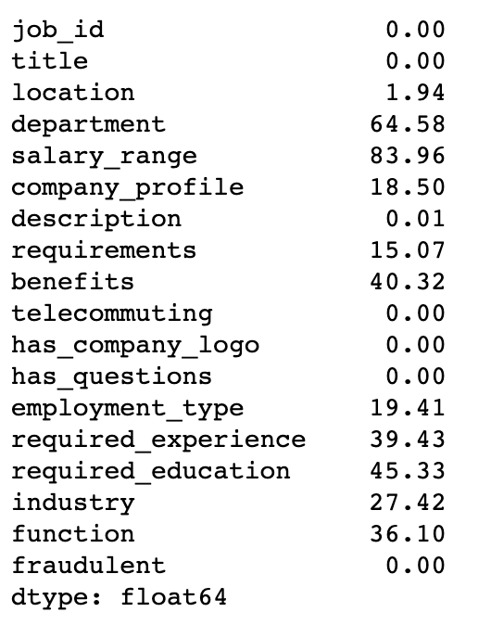
Handling Missing Values in the data
The column ‘salary_range’ had 84% missing data, so I dropped it from the data set as it showed no significance with more no. of missing values.
The remaining categorical columns with missing values appeared to be missing at random (MAR); at times, for categorical data the missing information is valuable and filling it with wrong info would lead to problems; in such cases we can replace them with ‘Unspecified’ or ‘Other’.
Where possible I re-used existing categories such as ‘unspecified’ or ‘Other’ to fill the missing values.

Slide 9
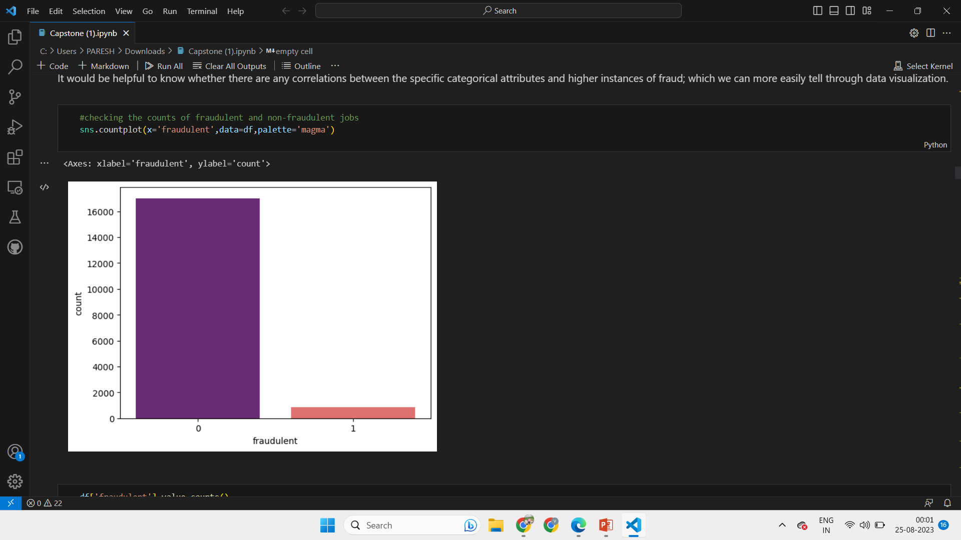
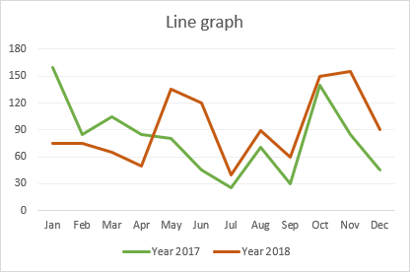
Visualizing the Data
The data set is highly imbalanced with very few fake job postings, which reflects real-world conditions (hopefully!) but visualization is still helpful to know if there are any natural correlations present in the data that I could identify.
By plotting some of the values I could determine that certain features such as the required education, the type of job, and duration of the job ( full time, part time, etc.) had higher correlation with the class label of fraudulent.
I visualized some graphs for required_education, job function, employee_type, experience, etc w.r.t to Fraudulent class.

Slide 10
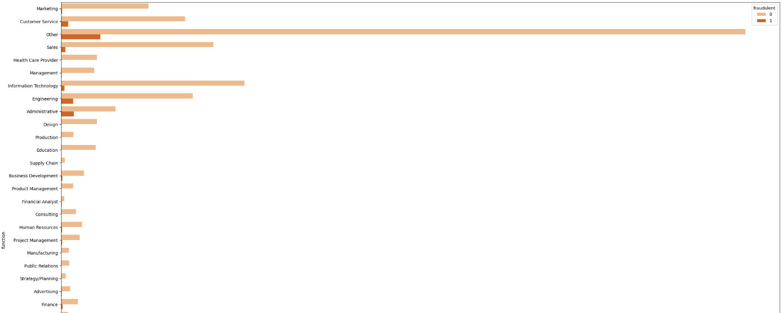
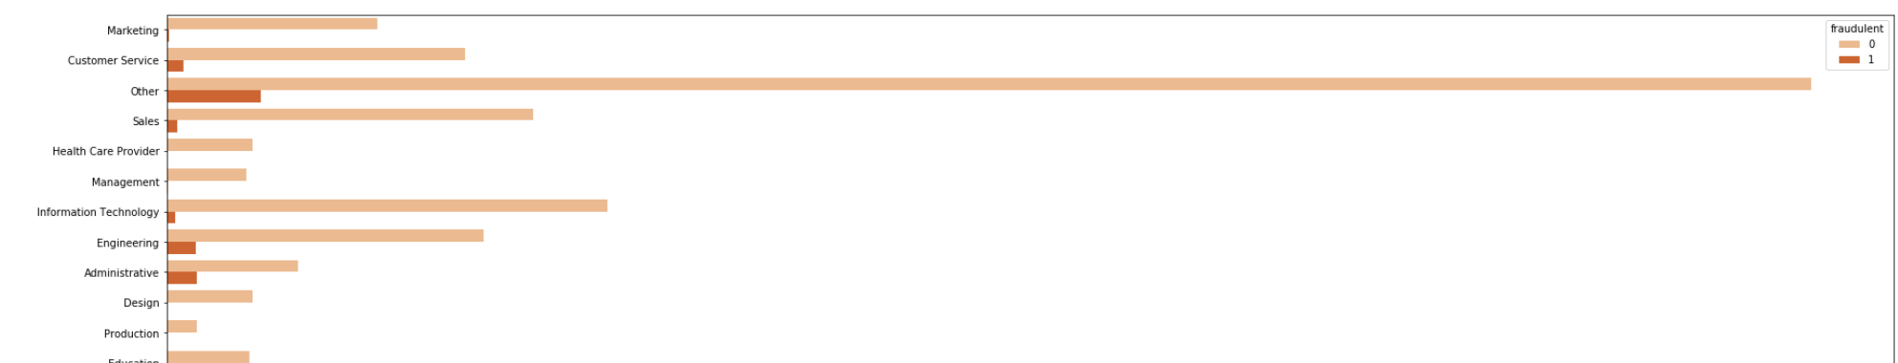
Job Postings Categorized as Engineering, Administrative have higher instances of fraudulent postings:

Slide 11
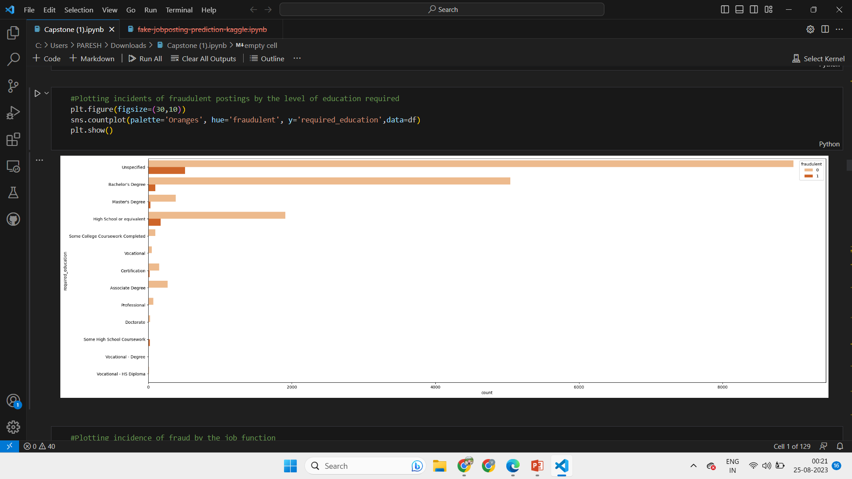
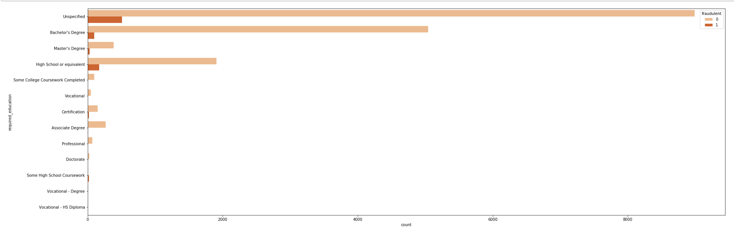
Jobs Postings Requiring a High School Diploma or Bachelors Degree or unspecified have higher instances of fraudulent postings:

Slide 12
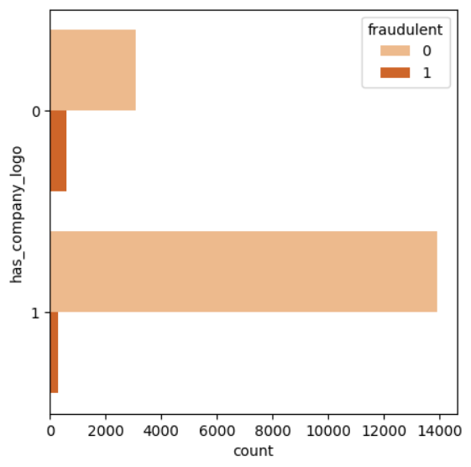
Jobs Postings where there is no company logo have higher instances of fraudulent postings:

Slide 13
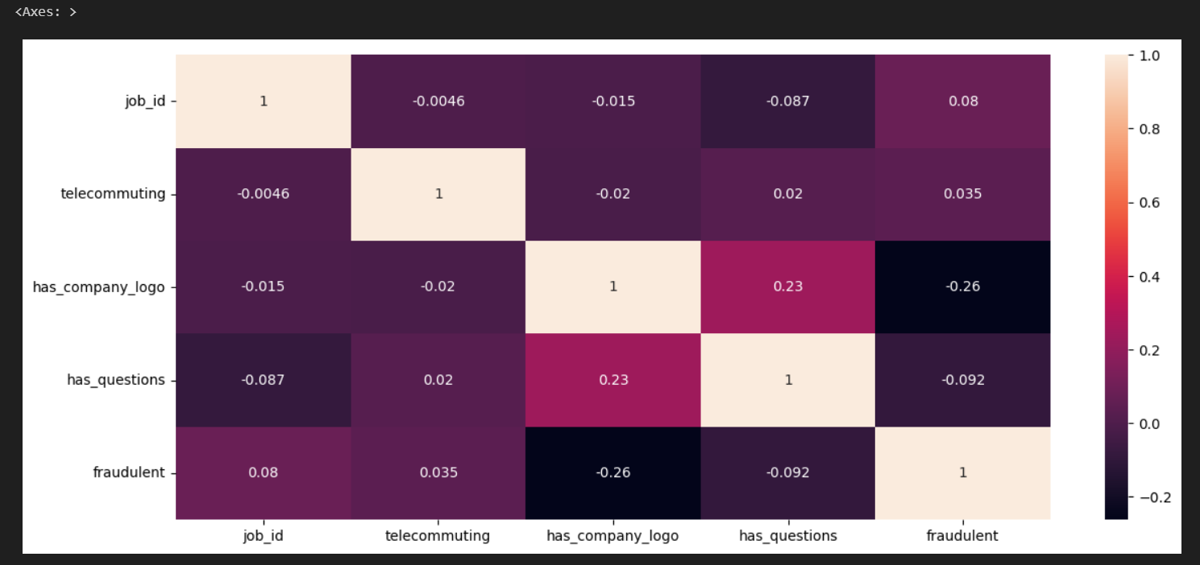
Corelation between different features:

Slide 14
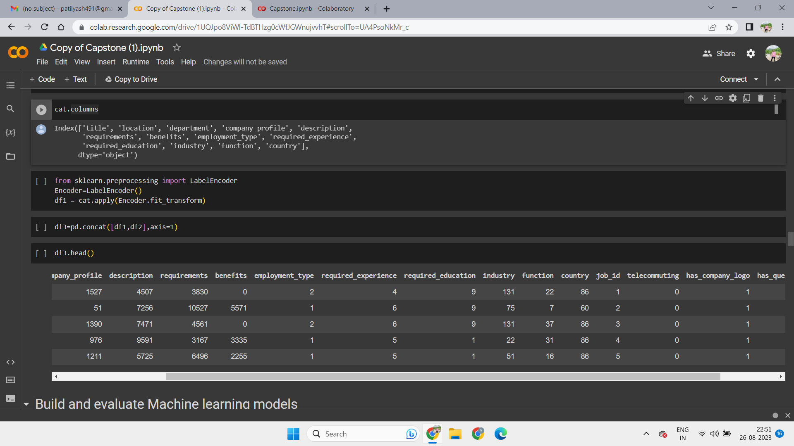
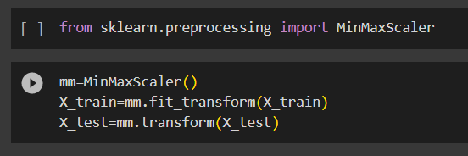
Encoding
Label Encoder
Label encoding is a technique used in data preprocessing, to convert categorical data into numerical form.
Label encoding assigns a unique integer to each category, allowing the data to be represented in a format that algorithms can work with.
In our data set we applied Label encoder as we had more number of categorical columns.
Scaling
Min-Max Scaler
Scaling, refers to the process of transforming features to a similar scale to improve the performance of algorithms.
we used Min-Max Scaling to transform our data features to a specific range, typically between 0 and 1.
After scaling, we go for splitting the data and train our models.

Slide 15
Model Training and Evaluation
For this project, I chose to train and evaluate the following machine learning models:
Logistic Regression
Decision Tree Classifier
Random Forest Classifier
K Nearest Neighbors Classifier
Gaussian Naive Bayes Classifier
Gradient Boosting

Slide 16
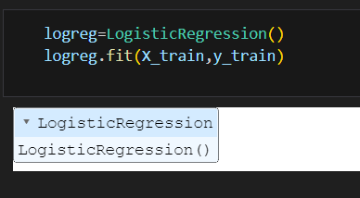
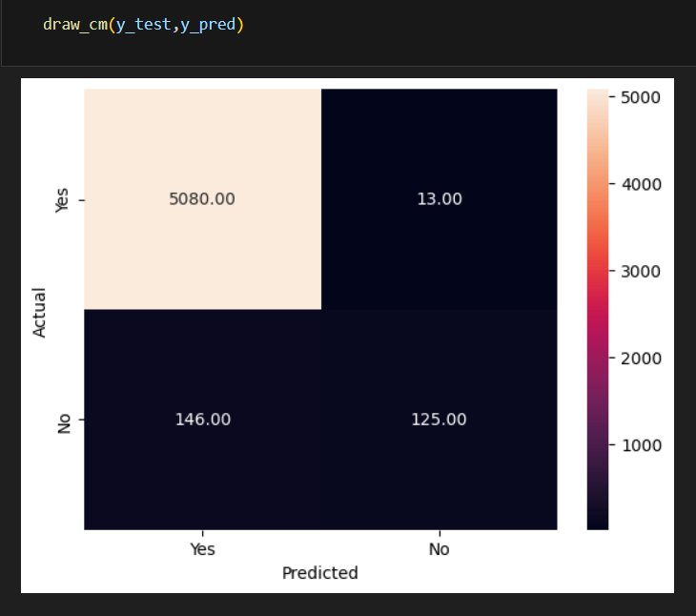
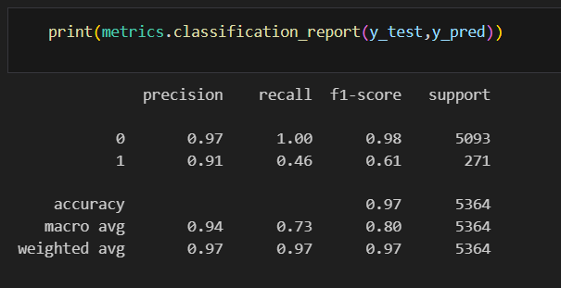
Logistic Regression
For the models Validation I used 70-30 split.(i.e 70% for training data and 30% testing data).
Logistic Regression establishes relationship between the independent and our output dependent variable.
It maximizes the likelihood and minimizes the Misclassification of data.
The Logistic Regression model achieved a weighted avg accuracy score of 97%.
Performance metrics used in logistic regression are Precision, recall, F1-score, accuracy.

Slide 17
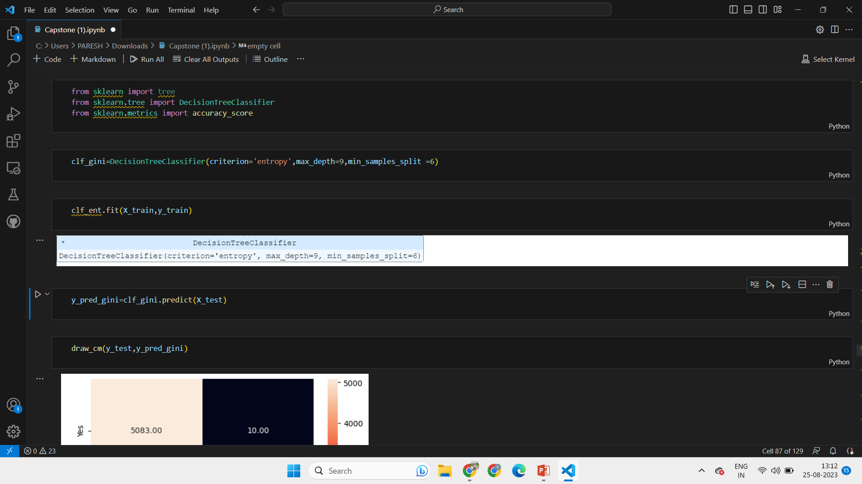
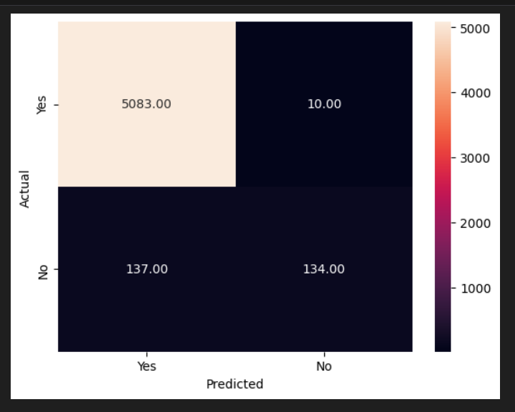
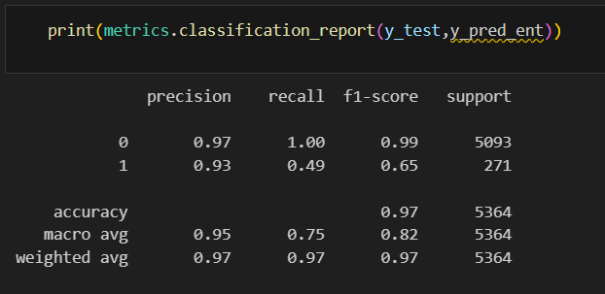
Decision Tree Classifier
For the models Validation I used 70-30 split.(i.e 70% for training data and 30% testing data).
Decision Tree is a rule based/Heuristic model. Which creates a tree structure with root node followed by leaves.
The criteria used is ‘Entropy’.
The Decision tree model achieved a weighted avg accuracy score of 97.2%.
Depth of tree acting as hyper-parameter gave best results at max-depth being-’9’ and min splits being-’6’.

Slide 18
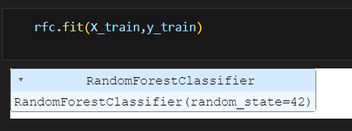
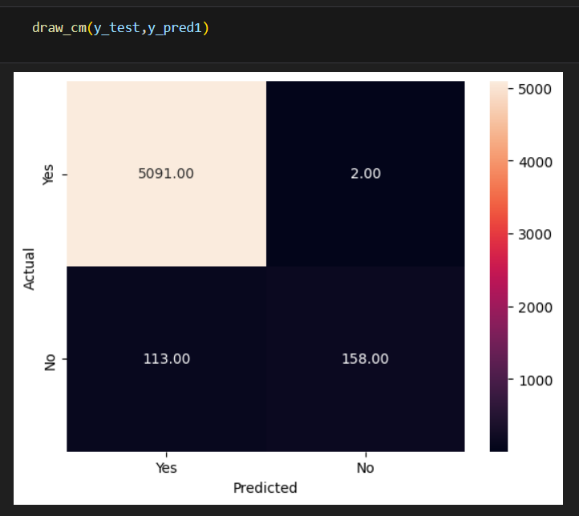
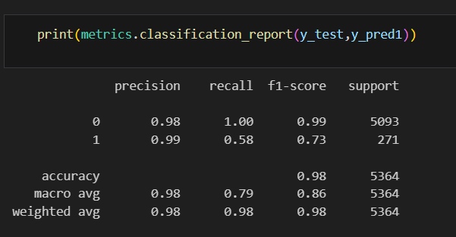
Random Forest Classifier
For the models Validation I used 70-30 split.(i.e 70% for training data and 30% testing data).
Random forest is multiple individual Decision tree’s working together. Random Forests can provide feature importance.
The Random Forest model achieved a weighted accuracy score of 98% and the RFC Classifier has area under curve as 80%.
The most important feature to inform this model was ‘has_company_logo’.
After tuning the parameters (GridSearchCV),the accuracy of model reduced to 94.64%. So, we kept the base model,

Slide 19
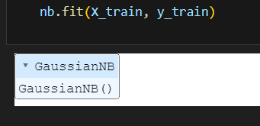
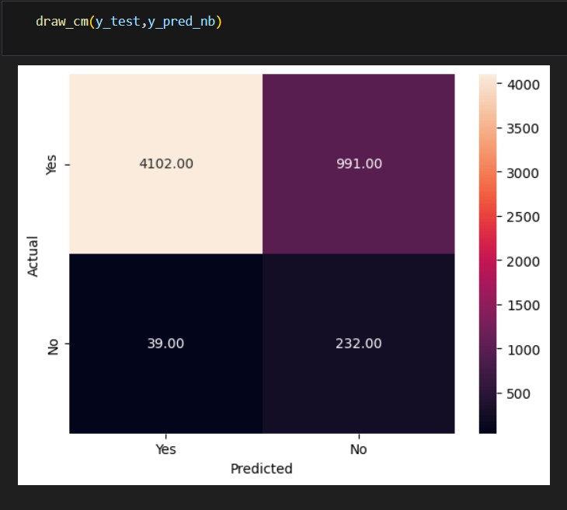
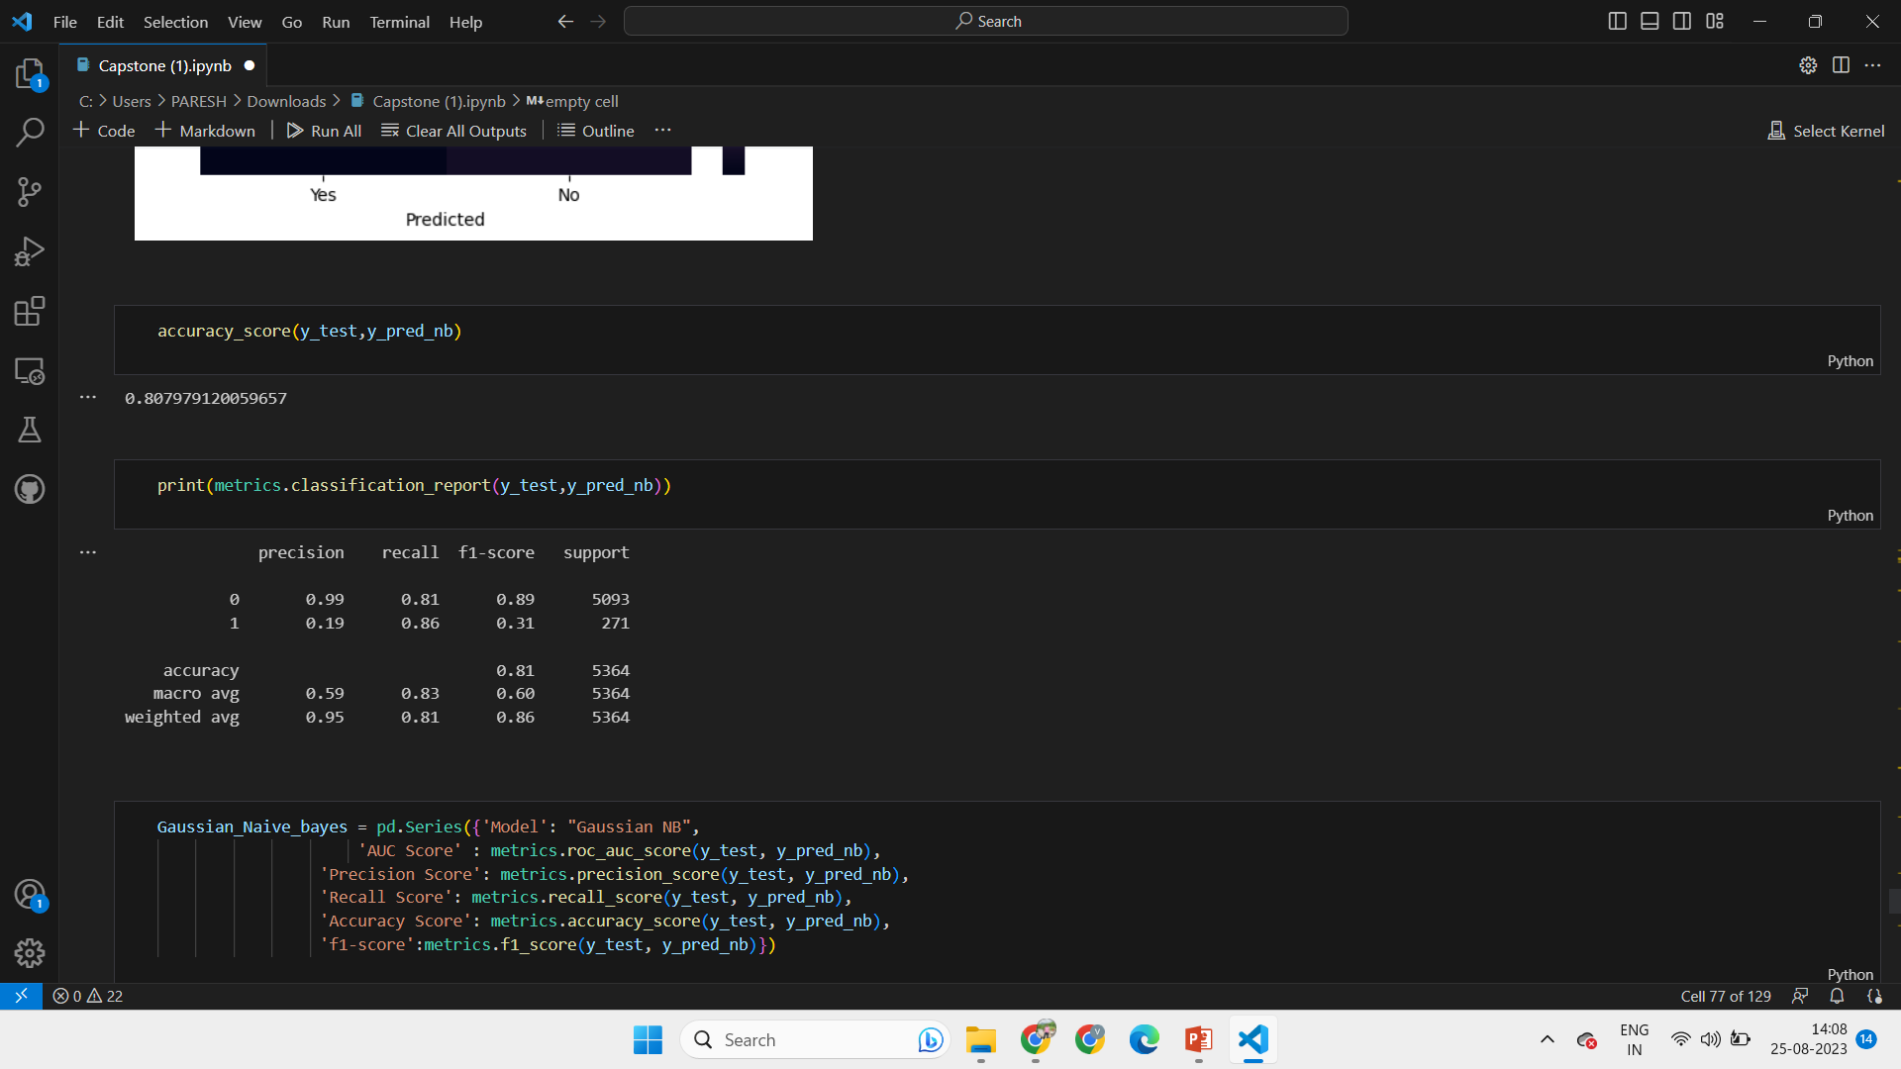
Gaussian Naive Bayes Classifier
It is based on is based on Bayes' theorem of conditional probability.
The Gaussian Naïve Bayes Classifier achieved less weighted avg accuracy score of 80%. Also it achieves a lower AUC as compared to other ML classifiers.
Gaussian NB may not be performing well on this data set due to complex relationships and strong dependencies between features and may have interfered with any distributions in the data.

Slide 20
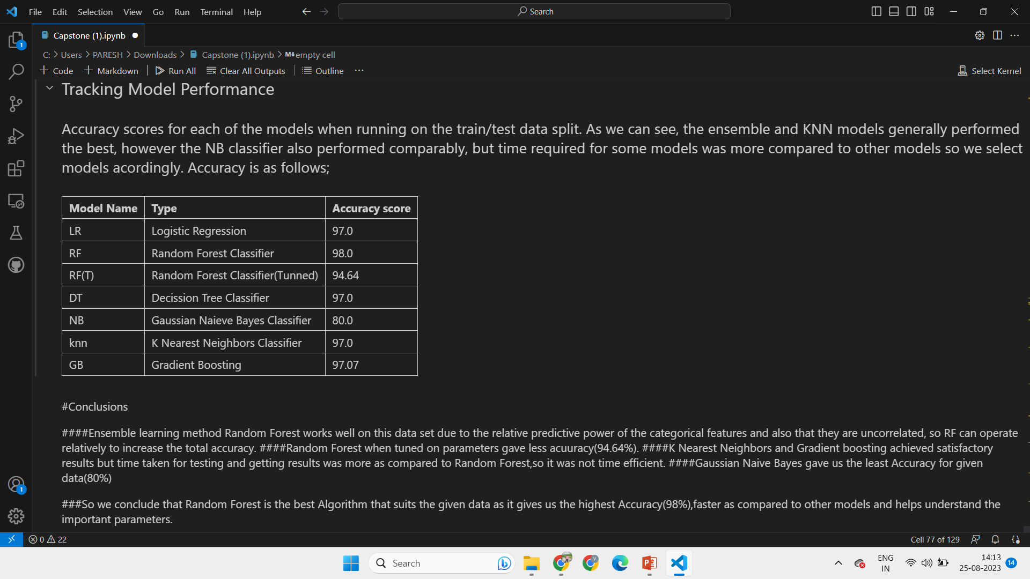
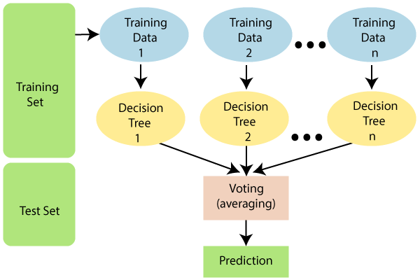
Comparing Classifier Prediction Accuracy
Random Forest

Slide 21
Conclusions:-
The ensemble learning method (Random Forest) achieved the highest level of classification accuracy in comparison to several models trained on this data set. This is because many of the original categorical features have more significance of prediction (as shown in the data visualization) and the features are relatively uncorrelated. Ensemble learning methods tends to work well for this type of data.
K Neighbors Classifier and Gradient boosting also performed good on this data but had the longest execution times making it less time efficient and difficult to do tuning or experimentation.
Gaussian Naive Bayes performed the worst. when using pandas to convert the categorical features or filling the null values, we created many additional records in features which may not necessarily be on a normal distribution frequency; which is why NB didn’t perform well.
So,after evaluating all the results we conclude that Random Forest classifier is the model that works best to predict the fraud jobs on the given data set information.
THANK YOU!

